Slide 1
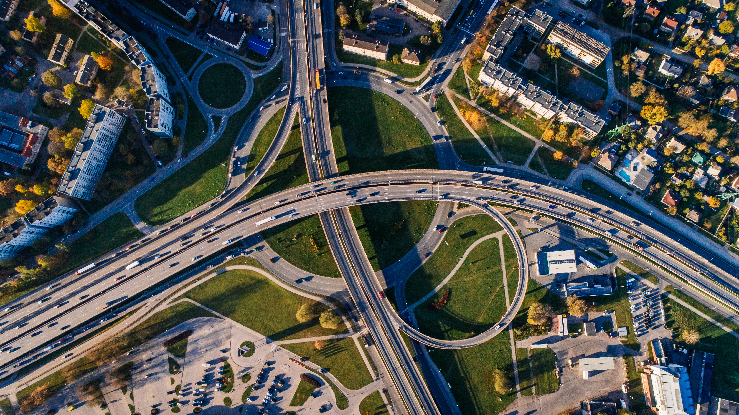
PUBLIC TRANSPORT EFFICIENCY

Slide 2

Presented by:
Aflah Cholayil
Reegan Aakish C
Sam Daniel Raj A
Ebinesh K
Sanjay B

Slide 3
DATA PREPROCESSING
Data preprocessing is an important step in the data analytics process that involves cleaning and transforming raw data to make it suitable for analysis. Some common steps in data preprocessing include: Data Cleaning: This involves identifying and correcting errors or inconsistencies in the data, such as missing values, outliers, and duplicates

Slide 4
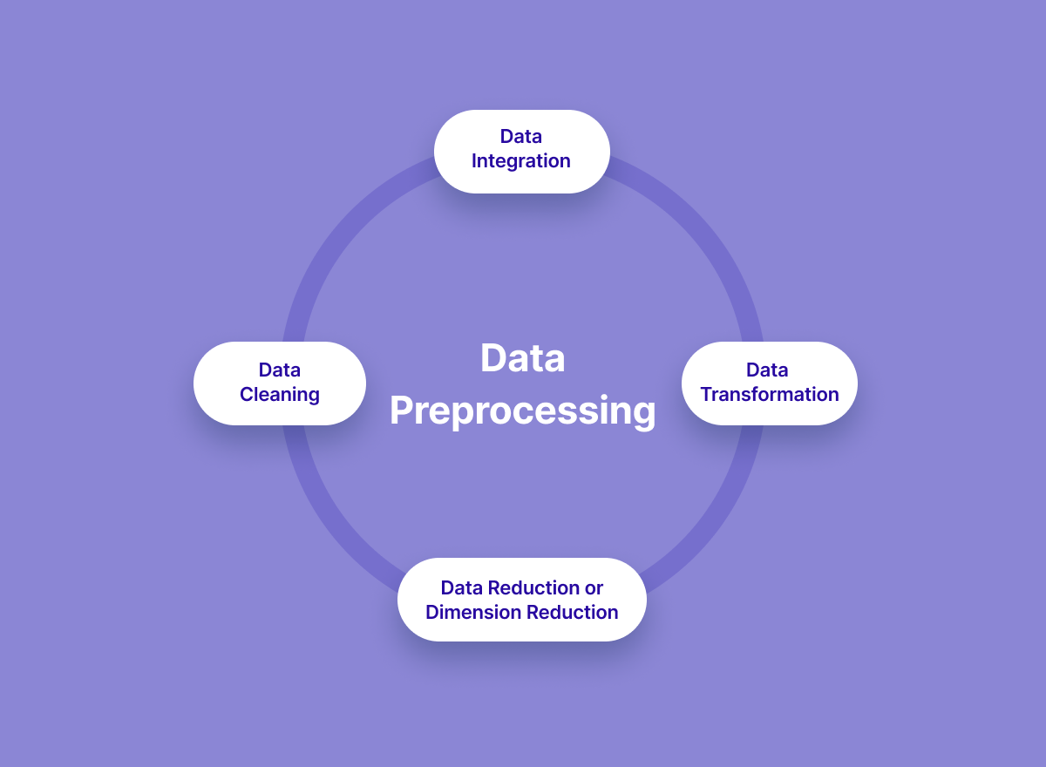
Steps to preprocess a dataset
Steps to preprocess a dataset

Slide 5
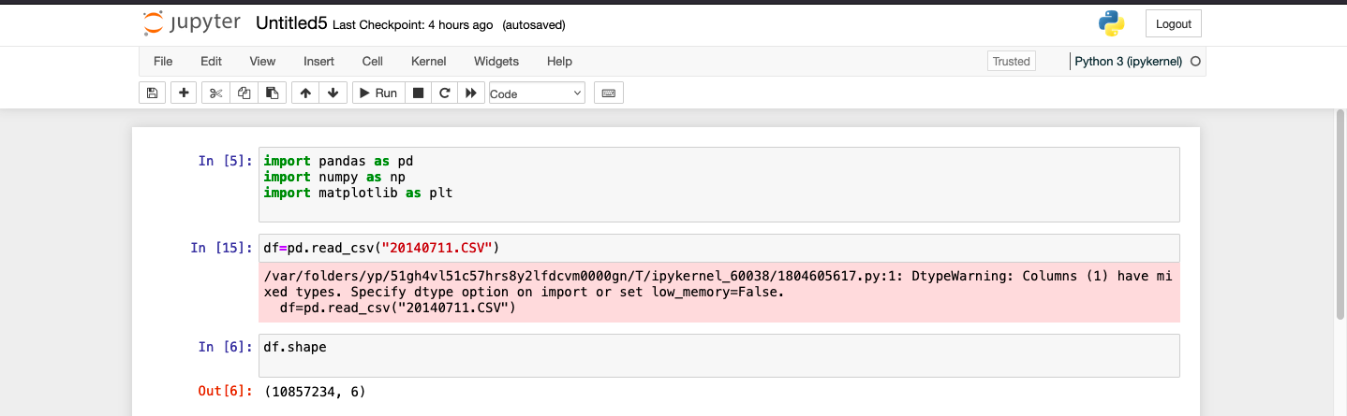
First we can import the required libraries
Import pandas as pd
Import numpy as np
To read the file df=pd.read_csv(‘20140711’) To see the size df.shape

Slide 6
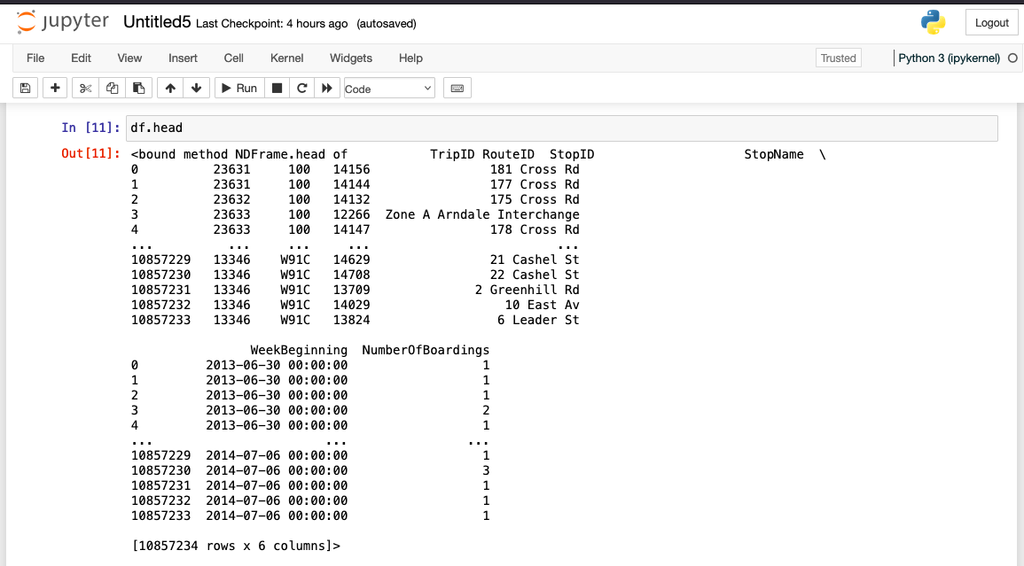
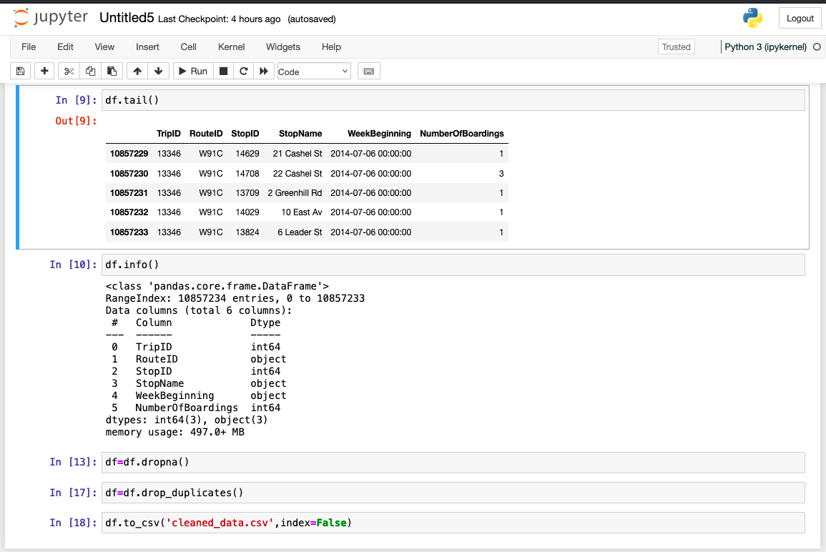
To get a head and tail in a dataset df.head df.tail

Slide 7
To remove duplicate from the dataset df=df.dropna() df-df.drop_duplicates()
To get info of the dataset
df.info()
To save the cleaned dataset df.to_csv(‘cleaned_data.csv’,index=False)

Slide 8
Thank you!!

